Slide 1
INTRODUCTION TO CE INFORMATION AND COMMUNICATION TECH.
10/2/2023

Slide 2
Objectives
Understanding the situation of ICT
Understanding the new trends of ICT
Understanding the new trends of CE

Slide 3
Contents
What is ICT and its contribution?
The 4th Industrial Revolution
Internet of Things
Trends of ICT Development

Slide 4
ICT and ITS CONTRIBUTION

Slide 5

What is ICT?

Slide 6
Definition
Anderson (2010):
The term ICT (Information and Communication Tech.) embraces the many technologies that enable us to receive information and communicate or exchange information with others. ICT encompass all the technologies by means of which we can detect these signals, interpret them and exchange information with others.
UNESCO (2010):
ICT as the forms of technology that are used to transmit, process, store, create, display, share or exchange information by electronic means.
Anderson, J. (2010). ICT TRANSFORMING EDUCATION: A Regional Guide. Bangkok, Thailand: UNESCO, Asia and Pacific Regional Bureau for Education.
UNESCO. (2010). ICT in Education programme. Bangkok, Thailand: UNESCO

Slide 7
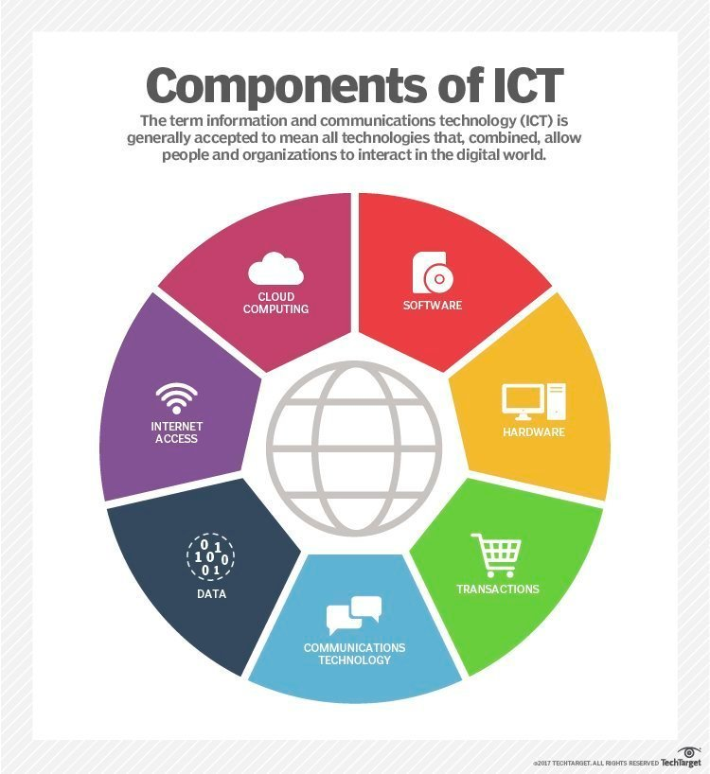
Components of ICT

Slide 8
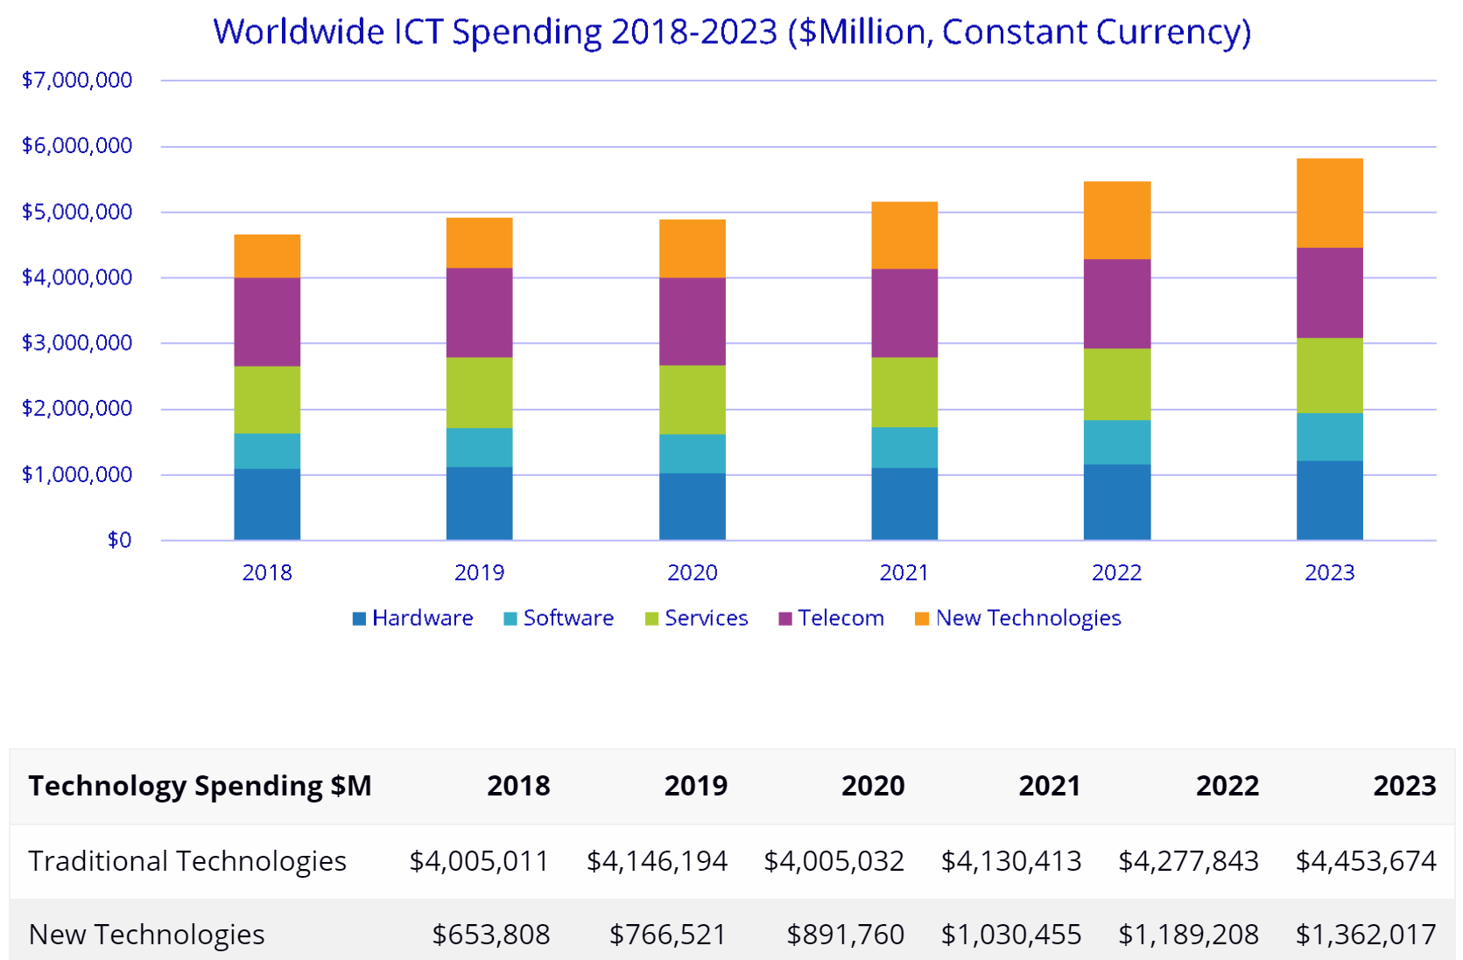
ICT Development
Source: IDC - Global ICT Spending Forecast 2020 – 2023, IDC Corporate USA, 2021.

Slide 9
ICT in Vietnam
Vietnam’s information and communication technology (ICT) industry posted average annual growth of 26.1% in the 2015-2019 period, according to the latest report from the Ministry of Information and Communications (MIC).
In the past five years, the ICT industry has continued to be the major economic sector of the country, with estimated revenue of US$110 billion in 2019.
Conference on Assessment of the Development Program of ICT Industry from 2015-2019 in the South of Vietnam, Tien Giang, June 2th, 2020.

Slide 10
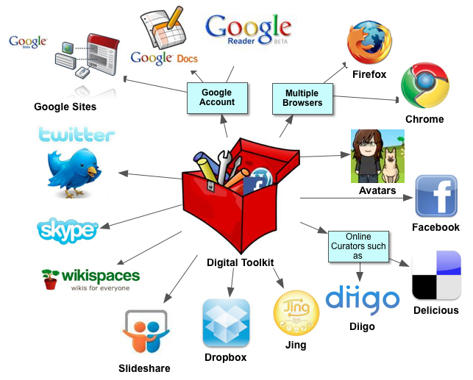
ICT Integtation to Education

Slide 11
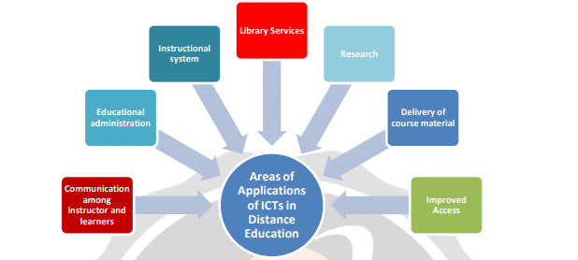
ICT Integtation to Education

Slide 12
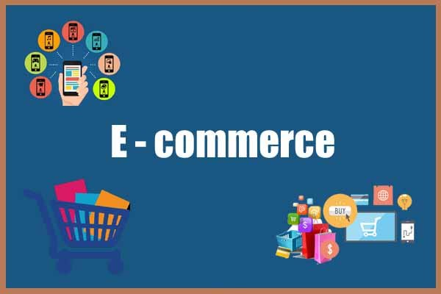
E-Commerce

Slide 13

E-Commerce

Slide 14
4th Industrial Revolution
Prof. Klaus Schwab
Founder and CEO of World Economic Forum

Slide 15
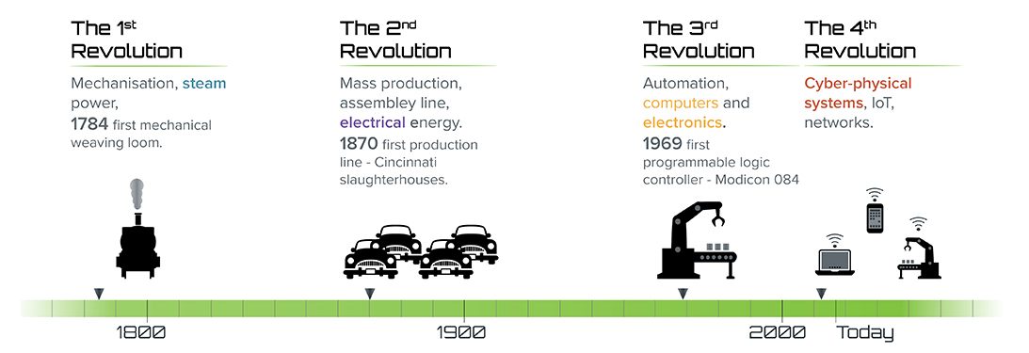
Industrial Revolution Timeline
World Economic Forum (Apr 13, 2016). The Fourth Industrial Revolution | Full Version. Retrieved from https://youtu.be/khjY5LWF3tg

Slide 16
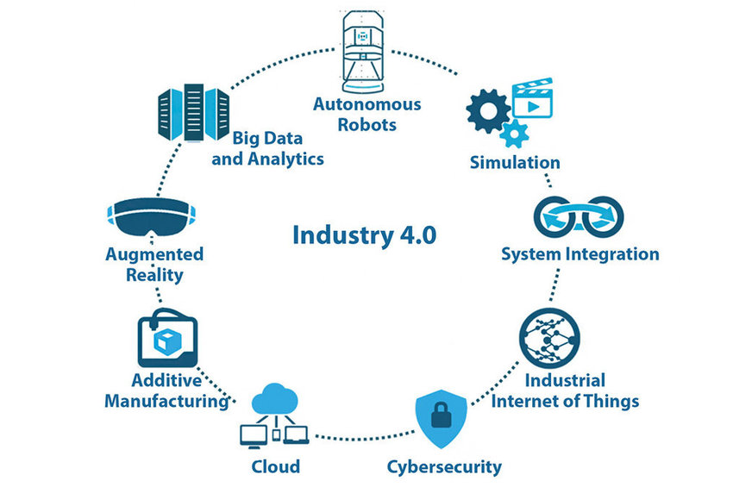
Industrial Revolution Timeline

Slide 17
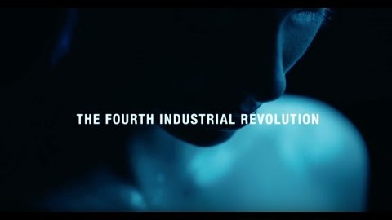
Introduction to 4th IR

Slide 18
Internet of Things

Slide 19
What is IoT?

Slide 20
Smart Things

Slide 21
The Need for IoT
Sensors
Local Processing
Local Storage
Network
Internet
Cloud Processing
Cloud Storage

Slide 22

IoT Applications

Slide 23
Trends of ICT Development

Slide 24
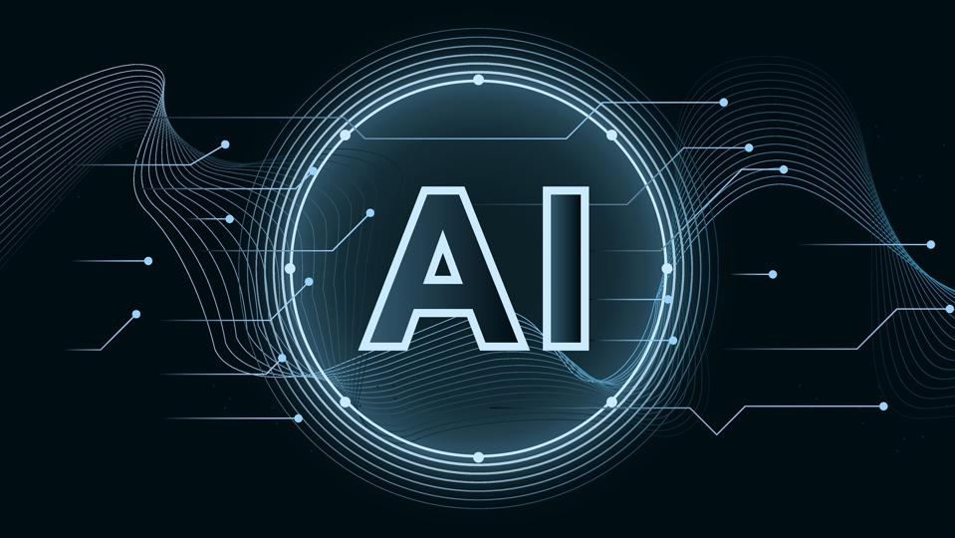
Industrial Revolution Timeline

Slide 25
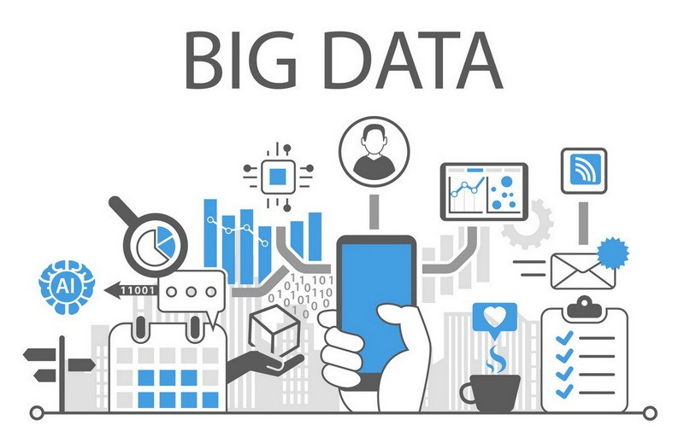
Industrial Revolution Timeline

Slide 26
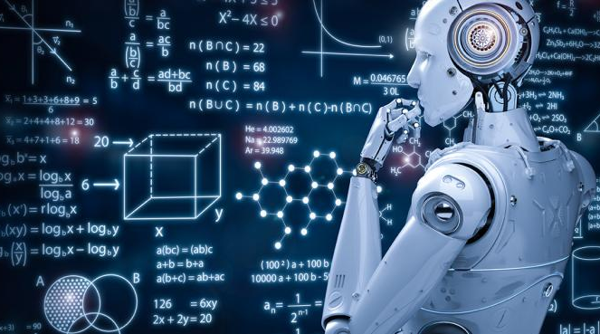
Machine Learning

Slide 27

Cyber-Physical Systems

Slide 28
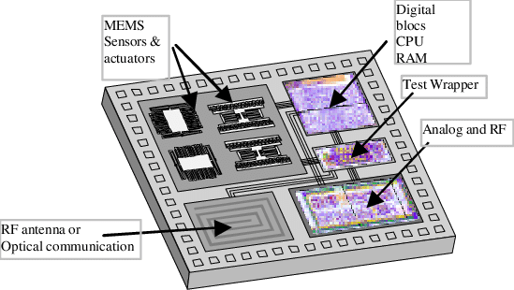
System-On-Chip (SoC)

Slide 29
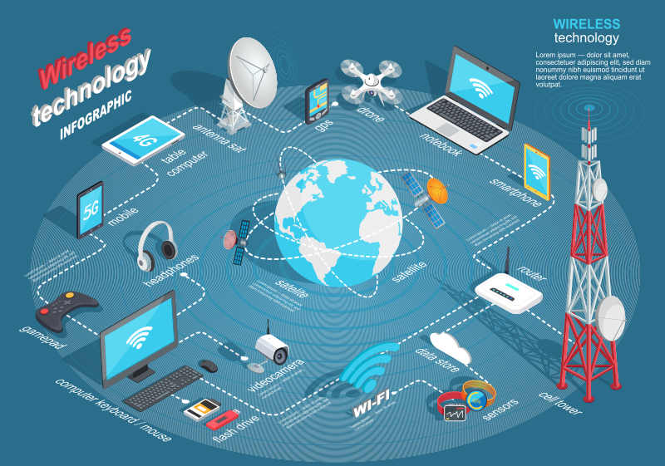
Wireless Technology

Slide 30

Q&A

